Slide 1
Tomato: A Food Delivery App using MERN
TEAM MEMBERS:
SHAKTHI PRIYAN
DANIEL DECRUEZ
DEENADAYALAN
DASARADAN

Slide 2
Introduction
In today's digital age, the convenience of ordering food online has revolutionized the food industry. With the increasing demand for seamless and fast services, restaurants and food delivery platforms are leveraging technology to provide users with efficient, user-friendly solutions.
Our project is a Food Ordering App developed using the MERN stack (MongoDB, Express.js, React.js, Node.js). This technology stack was chosen for its ability to build dynamic, responsive, and scalable web applications. The app provides users with a streamlined experience to browse menus, place orders, and track deliveries, all in one unified platform.
The goal of this project is to deliver a solution that is not only functional but also user-centric. Through the integration of powerful technologies like React.js for the frontend, Node.js and Express.js for the backend, and MongoDB for data management, this app is designed to be both flexible and scalable, meeting the needs of both users and businesses.

Slide 3
Features
User-Friendly Interface
Real-Time Order Tracking
Secure User Authentication
Menu and Cart Management
Secure Payment Processing
Discounts and Promotions

Slide 4
Proposed System / Future Implementation
User-Friendly Order Customization
Multi-Platform Mobile App
Subscription-Based Model
Loyalty Programs and Rewards
Discount and Promo Code Integration
proposed implementations focus on enhancing the user experience and adding essential features like order customization and push notifications, while the future implementations aim to leverage advanced technologies such as AI-based recommendations, voice-enabled ordering, and loyalty programs to keep the app competitive and engaging in the long term

Slide 5
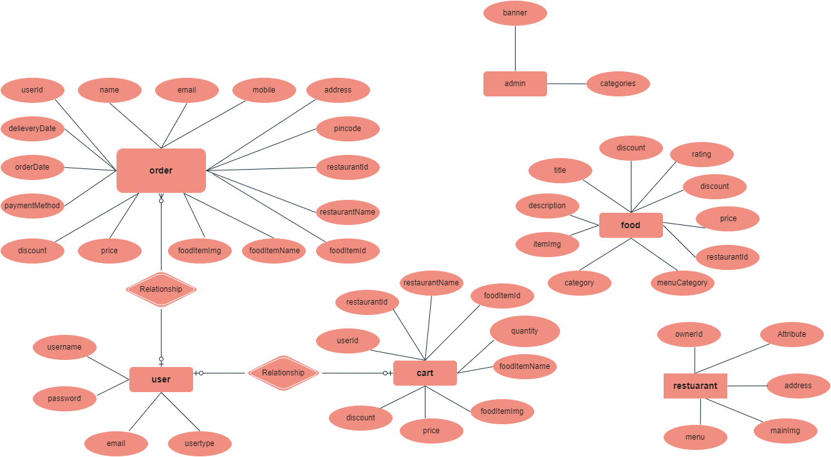
Architecture Diagram

Slide 6
Front-End Development
The frontend development of the Food Ordering App focuses on creating a smooth, intuitive, and visually appealing user experience. It’s built using React.js, a powerful JavaScript library, ensuring a responsive and dynamic interface.
React.js (Core Framework)
Role: React.js is used to build the entire frontend. It allows for the creation of reusable and modular components, making the development process faster and more efficient.
2. Responsive Design:
Role: Ensuring the app works seamlessly across devices (mobile, tablet, desktop) by using CSS and Bootstrap for responsiveness.
3. State Management with Redux:
Role: Redux is used for managing the application’s state, ensuring that data like cart items, user login status, and order details remain consistent throughout the app.

Slide 7
Back-End Development
1. Node.js (Server-Side Runtime)
Role: Node.js provides a fast and scalable runtime environment to execute JavaScript code on the server-side. It is designed to handle asynchronous operations, making it perfect for real-time applications like food ordering.
2.Express.js
Role: Handles API endpoints such as GET requests for menus, POST requests for new orders, and PUT requests for updating order statuse.Manages tasks like authentication, input validation, and error handling.
3. MongoDB (Database)
Role: MongoDB is a NoSQL database used to store structured and unstructured data in a document-oriented format.
5. User Authentication (JWT - JSON Web Tokens)
Role: JWT is used to securely manage user authentication and maintain session information.
6. Payment Processing (Stripe API)
Role: Stripe API is integrated for secure payment handling, allowing users to pay for their orders using credit/debit cards or digital wallets.

Slide 8
CHALLENGES
Real-Time Order Updates and Tracking:
Challenge: Implementing real-time updates for both users and restaurants was complex, as it required maintaining constant communication between the server, frontend, and database.
Solution: Using WebSockets or polling techniques, we enabled real-time tracking and updates for order status, ensuring users stay informed about their order progress.
2. Handling High Traffic and Scalability:
Challenge: Ensuring the app remains responsive during peak hours with a high volume of users and orders posed scalability issues.
Solution: The app was designed with Node.js and MongoDB, which allowed for non-blocking, asynchronous operations, and horizontal scaling, making the backend capable of handling a large number of concurrent requests.

Slide 9
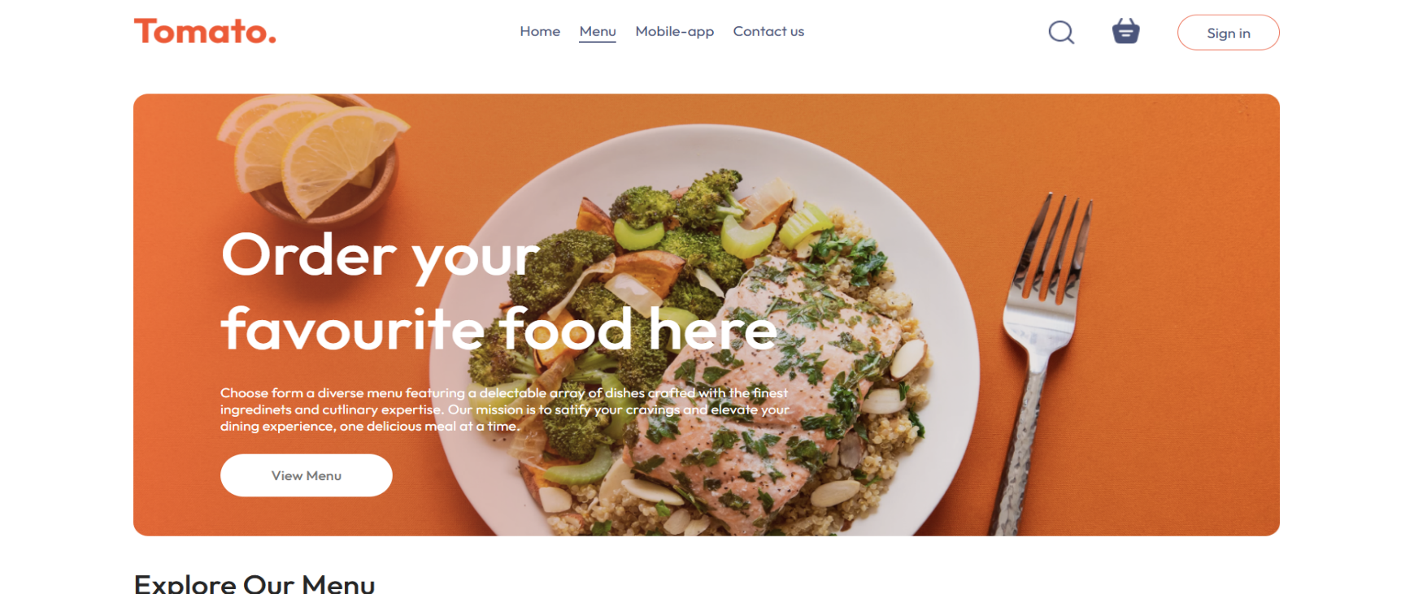
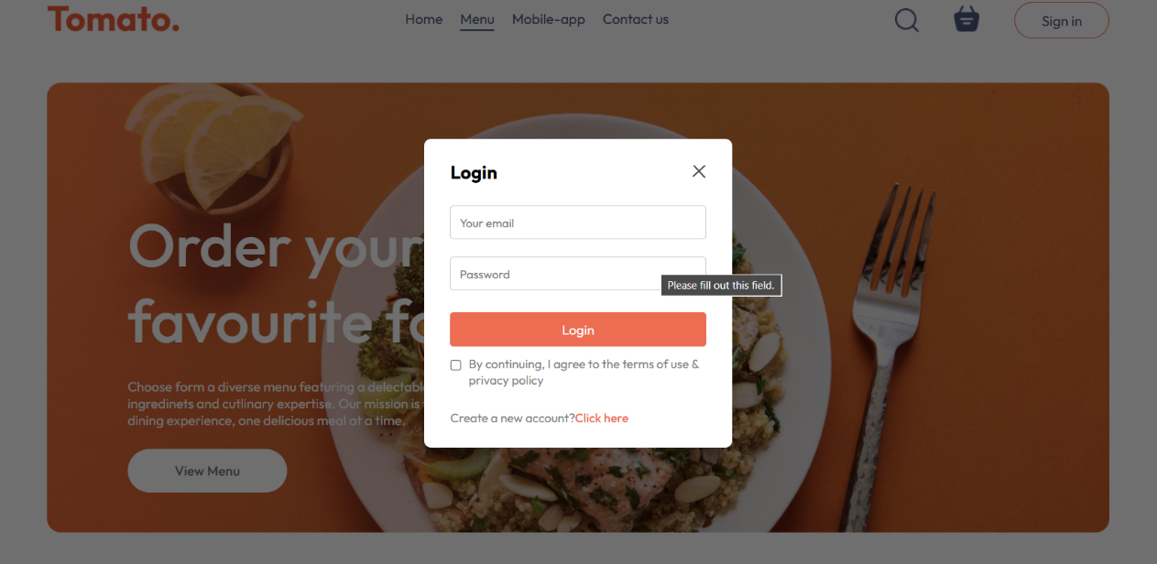
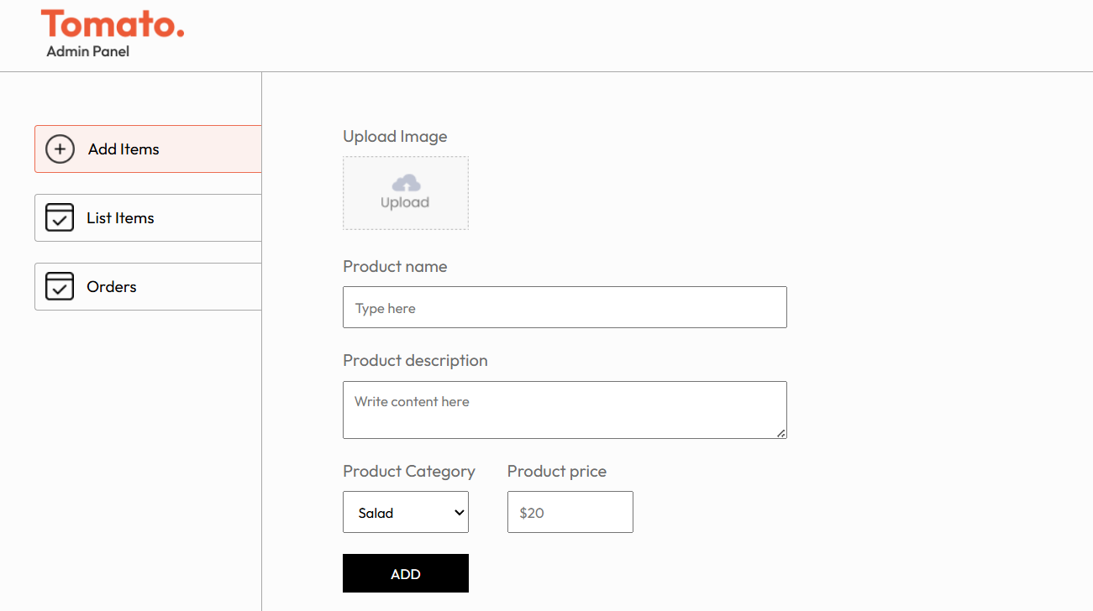
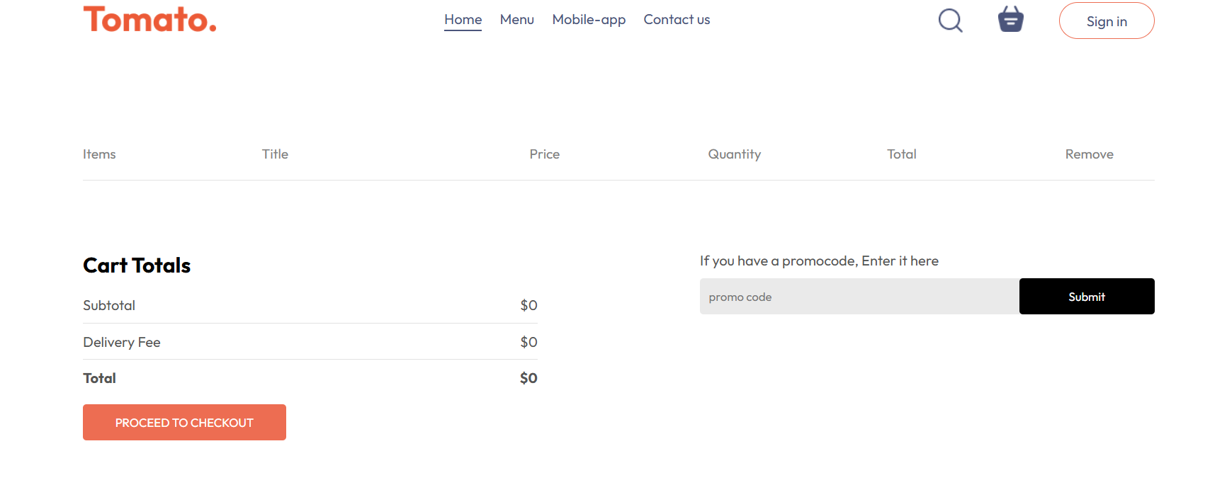
Model

Slide 10
Conclusion
Tomato offers an innovative, real-time food delivery solution powered by the MERN stack.
The app prioritizes user experience, secure transactions, and scalable architecture, making it a reliable platform for both customers and restaurants.
With planned future enhancements, Tomato is set to revolutionize online food ordering.

